Slide 1
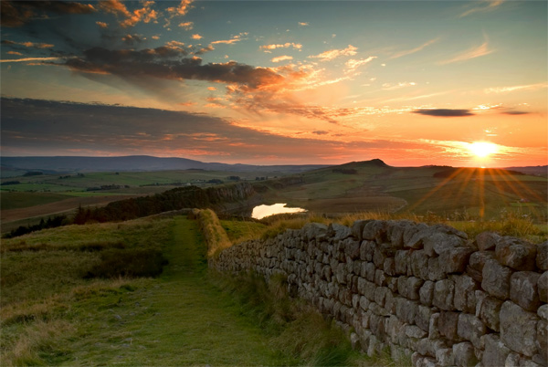
Hadrian`s wall

Slide 2
The Handrian`s Wall looks like The Chinese Wall but Handrian`s Wall is smaller than Chinese Wall. It was built by Roman emperor Handrian between 122 and 130 year.
Today The Handrian`s Wall is light copy of that which was sometime. In 1987 Unesco includes Handrian`s Wall in the list with world cultural heritage with name – Roman Wall.

Slide 3
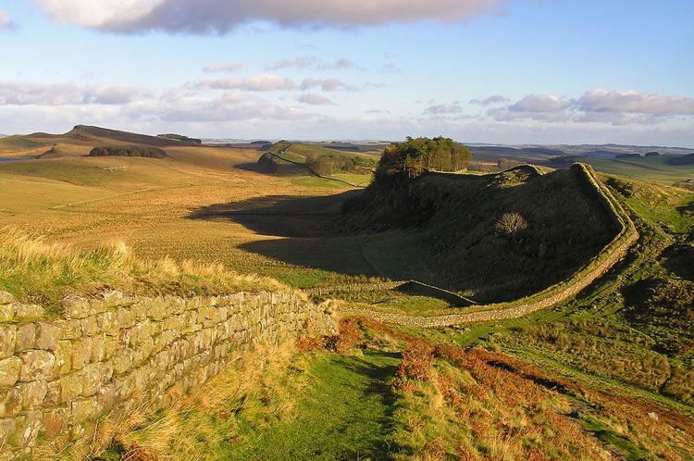

Slide 4
Handrian Wall is on hills in north England. It was built between the North sea and Irish sea. The Wall was long 120 kilometers and it was high three metres. It goals was to protected Romans of invasion of Pictish.

Slide 5
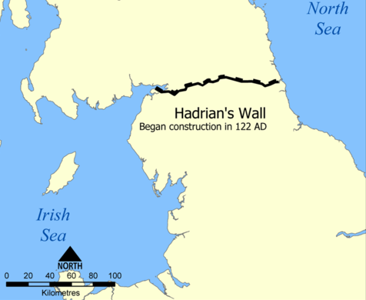

Slide 6
Today Handrian`s Wall is one of the most popular historical lendmarks of Britain and it is visit of one milion tourists of year. There is build small restaurant and cafes.

Slide 7
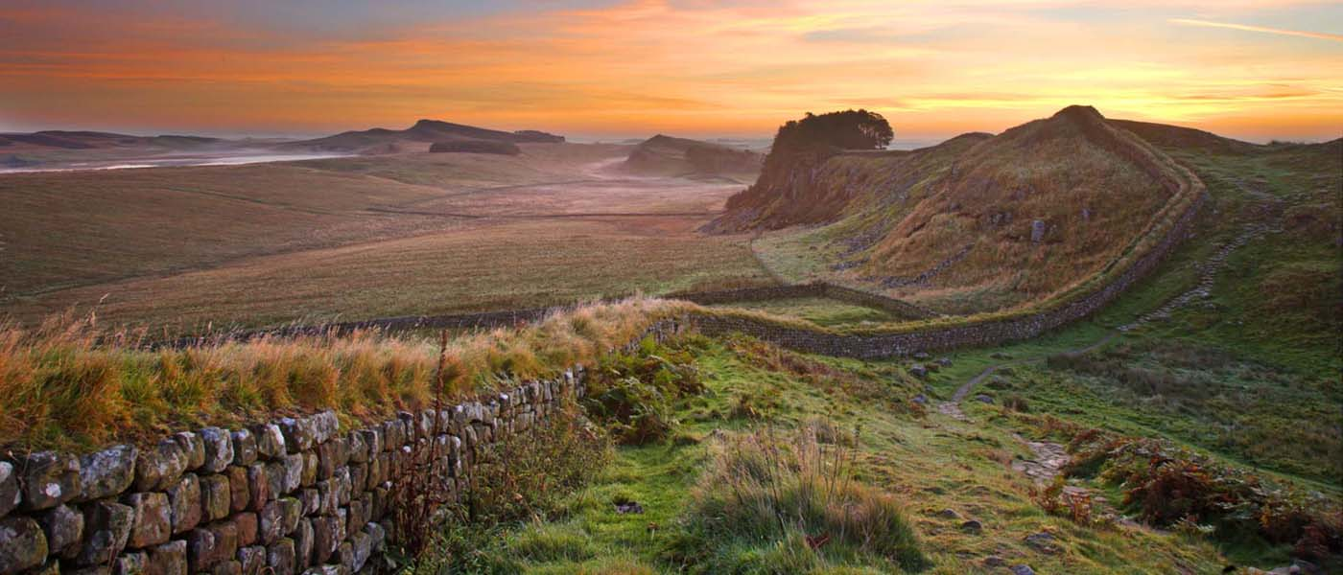
Prepared : Julia Todorova 8 A class

